Slide 1
IATA EASY PAY
CAIRO, 21-Jul-2019

Slide 2
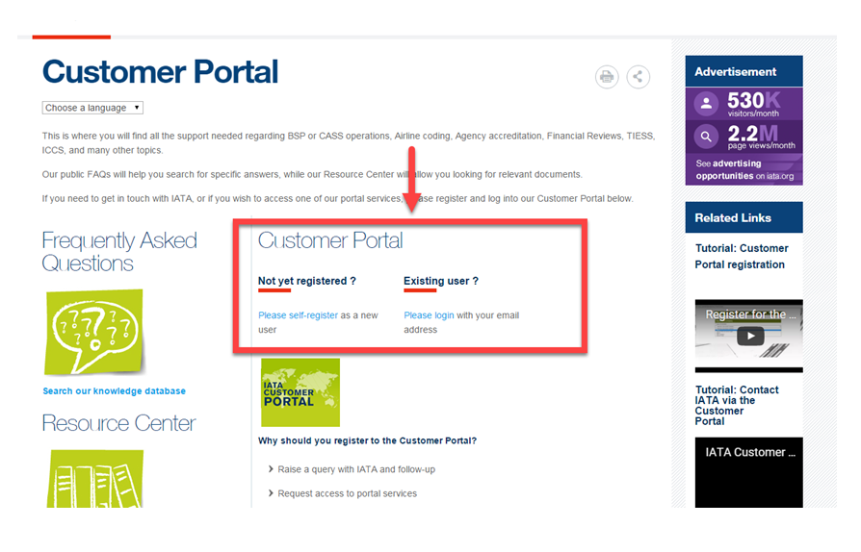

Slide 3
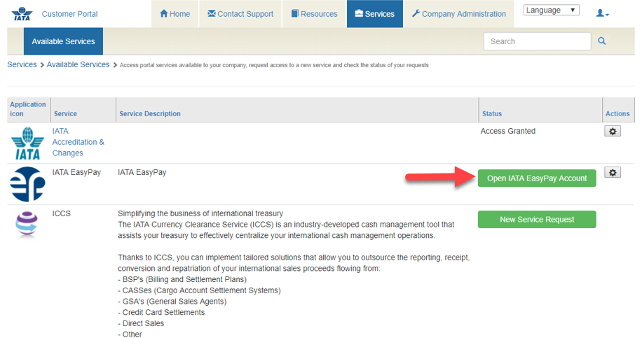

Slide 4
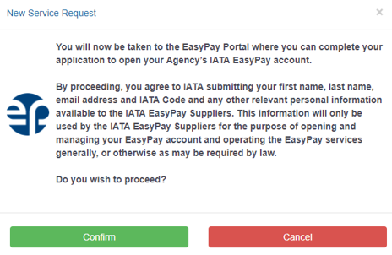

Slide 6
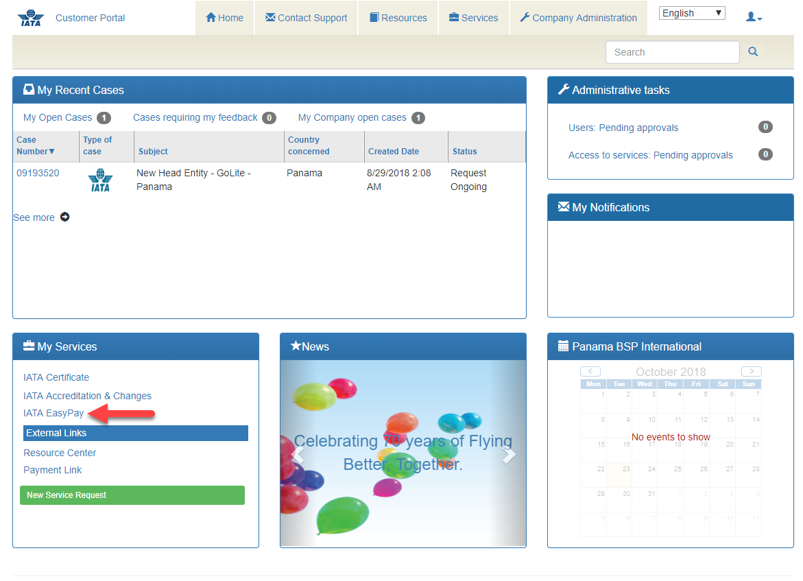

Slide 7
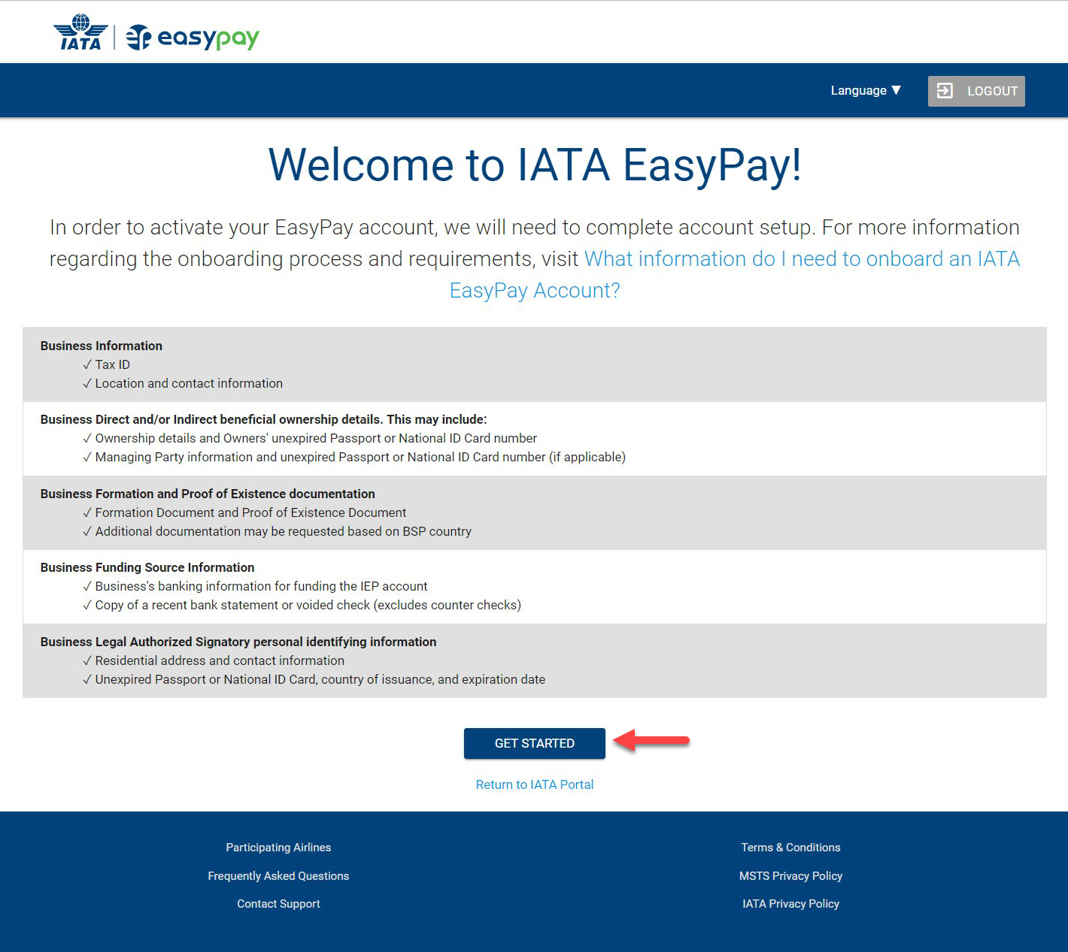

Slide 8
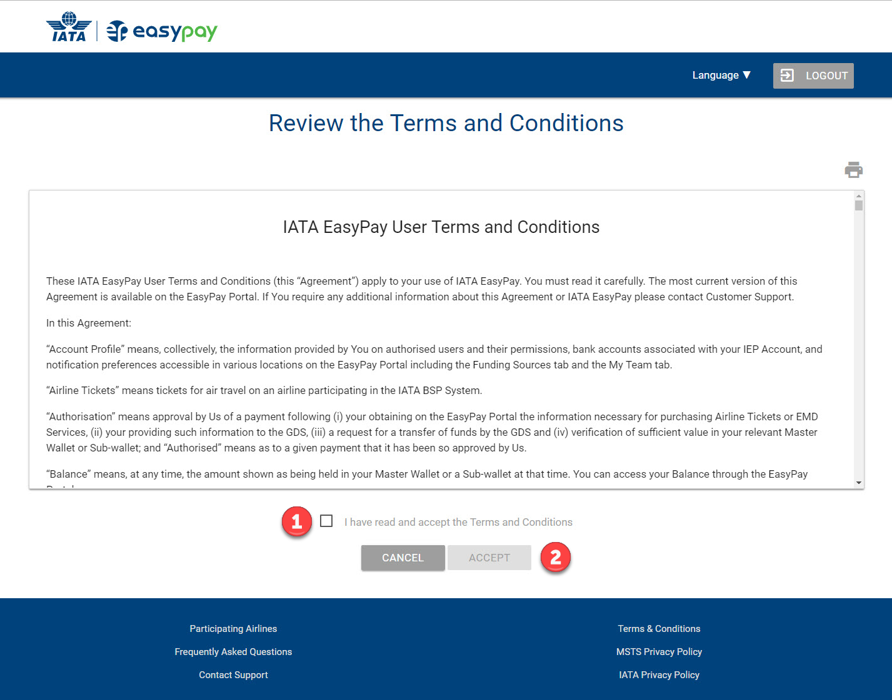

Slide 9
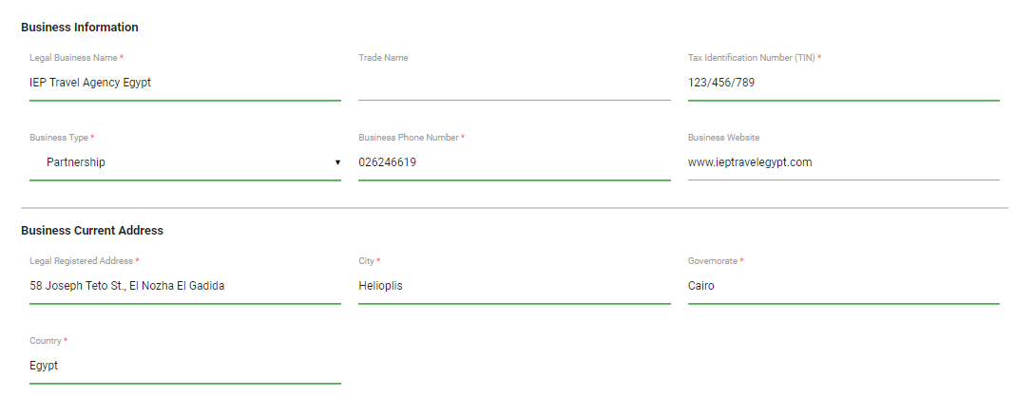
General Information

Slide 10
You must provide all the following:
Full Legal Name of the Company
Doing Business as or Trade Name (if applicable)
Tax Identification Number
Type of Company
Business Phone Number
Business Website
Current Business Address
Country where Business was Established
Estimated Gross Ticket Sales for Next Two Years
Business Contact and Ts & Cs Signer Information

Slide 11
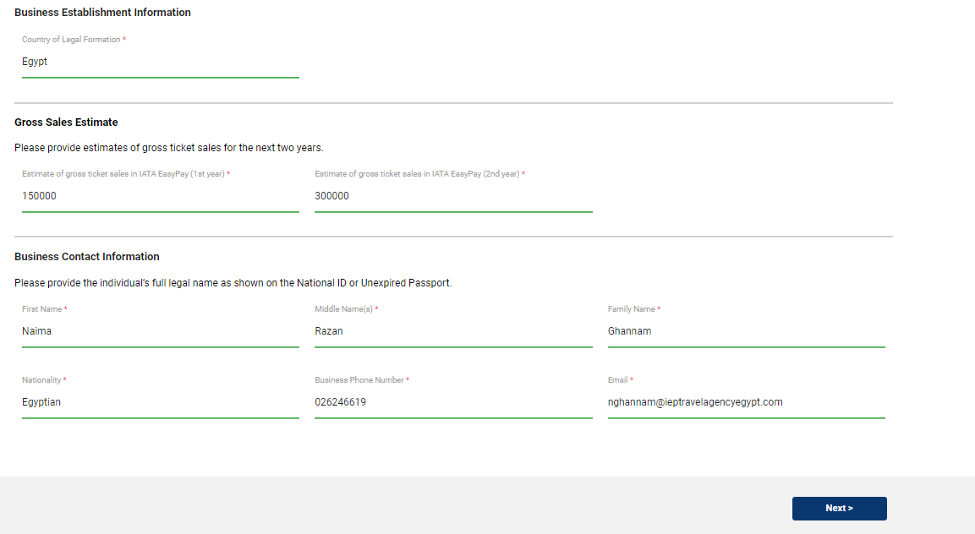

Slide 12
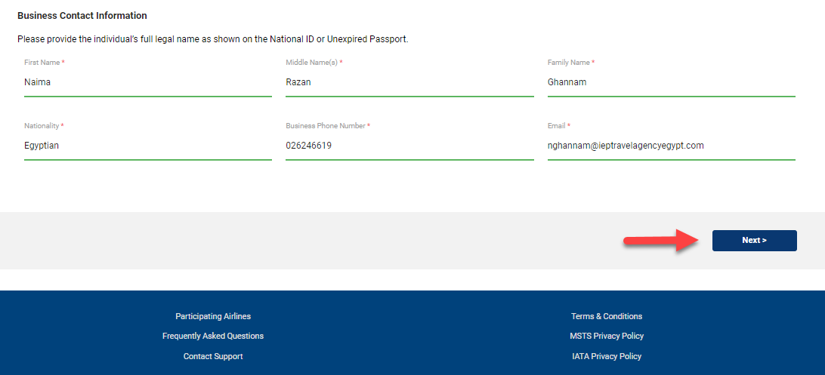
EASY PAY Administrator Information

Slide 13
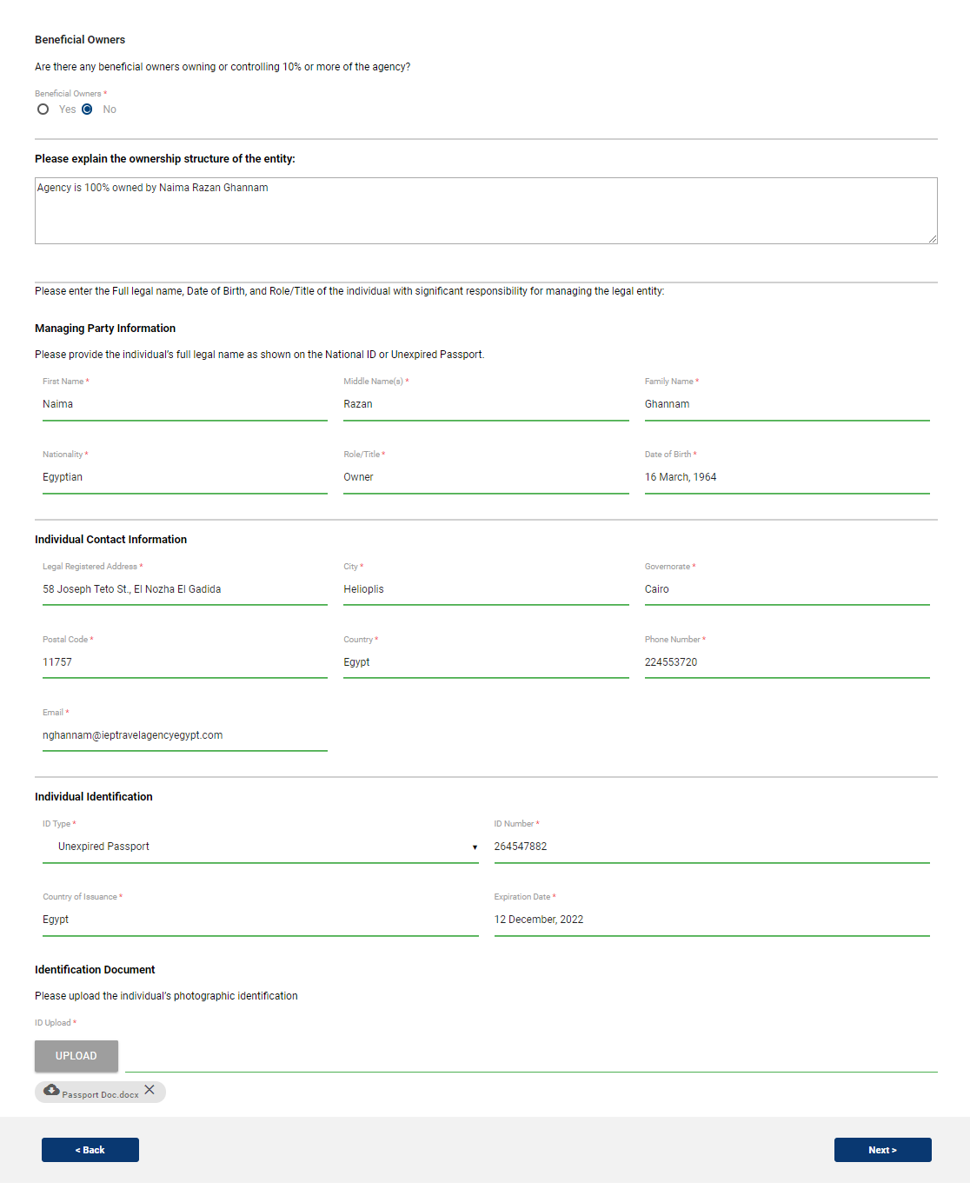
Ownership

Slide 14
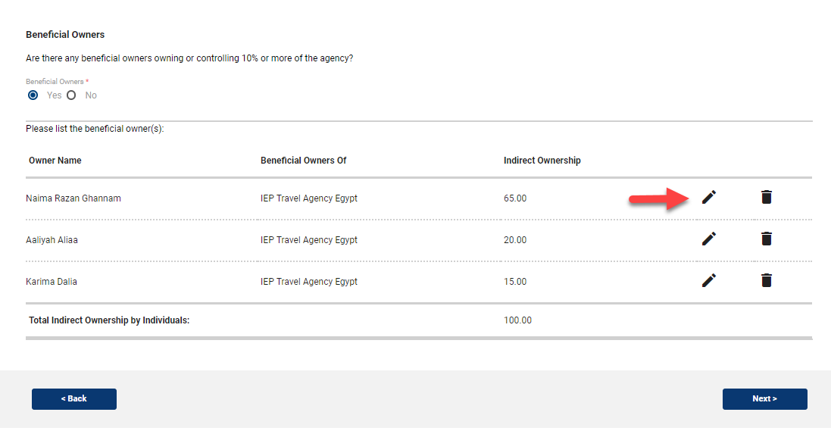

Slide 15
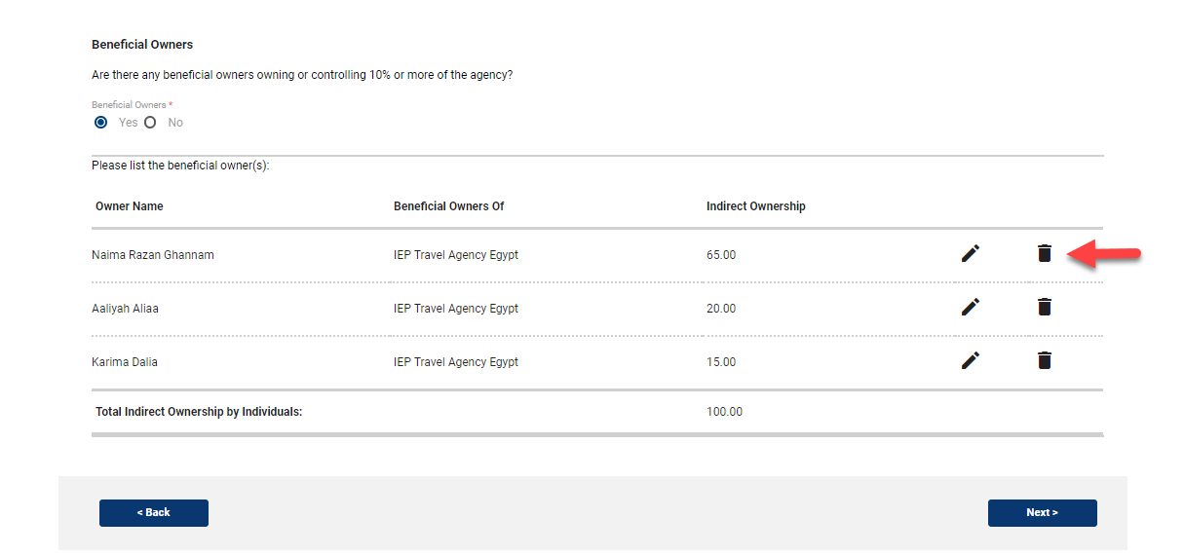
To remove an owner, click the trash bin icon (delete) to the right of the edit icon

Slide 16
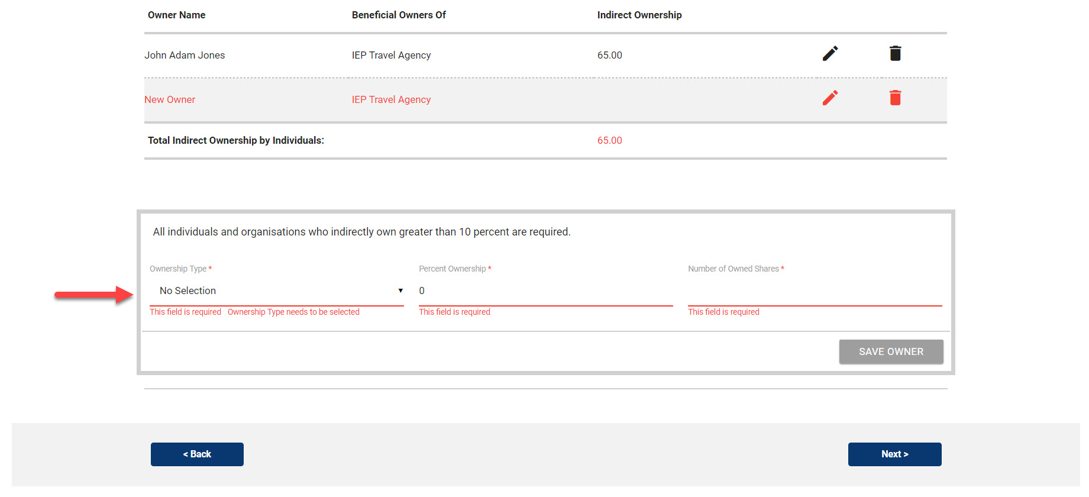

Slide 17
Once you have fulfilled the 10% requirement, the table will display as seen below:

Slide 18
If any information is missing and the 10% requirement is not complete, you will see the table show an ownership line in red, prompting you to continue entering in ownership information.

Slide 20
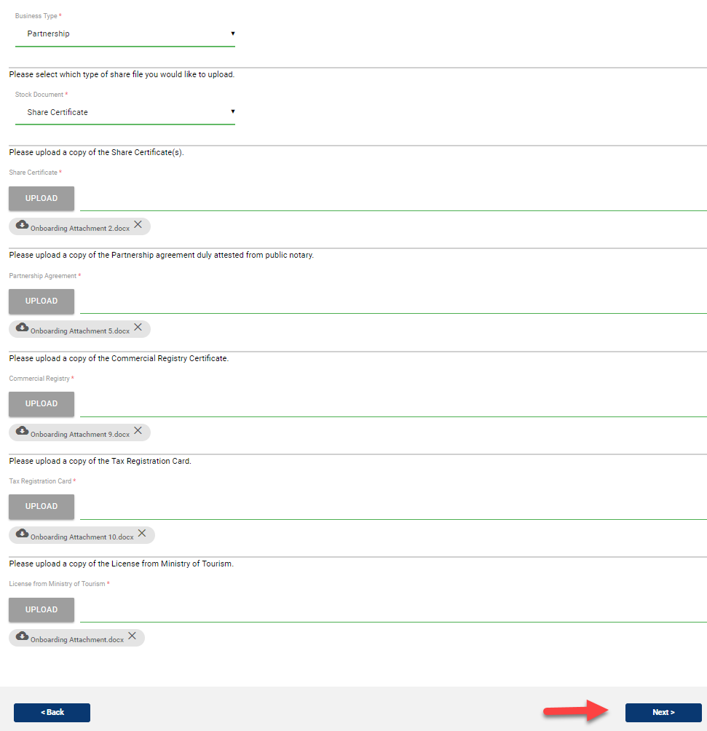
Documents

Slide 21
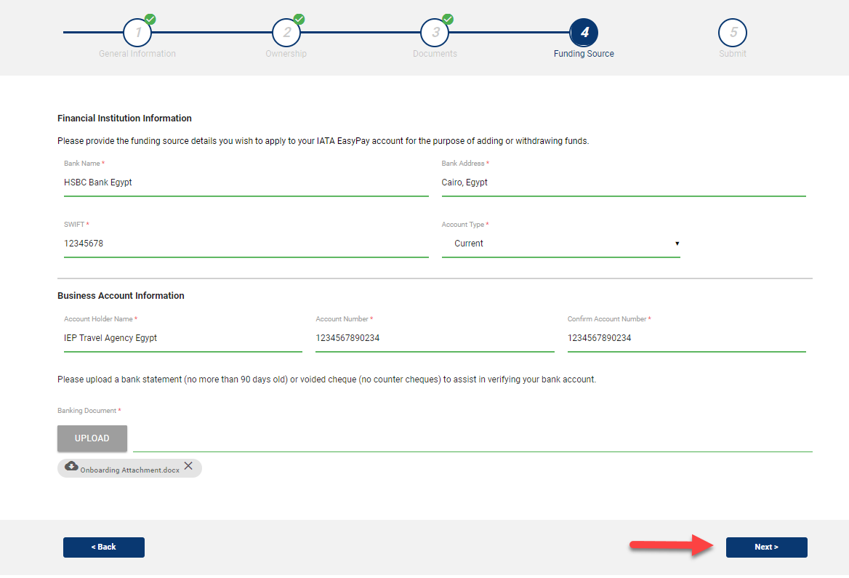
Funding Source
Only one bank account can be added for an entity, and funds will be transferred from (and withdrawn to) this bank account.

Slide 23
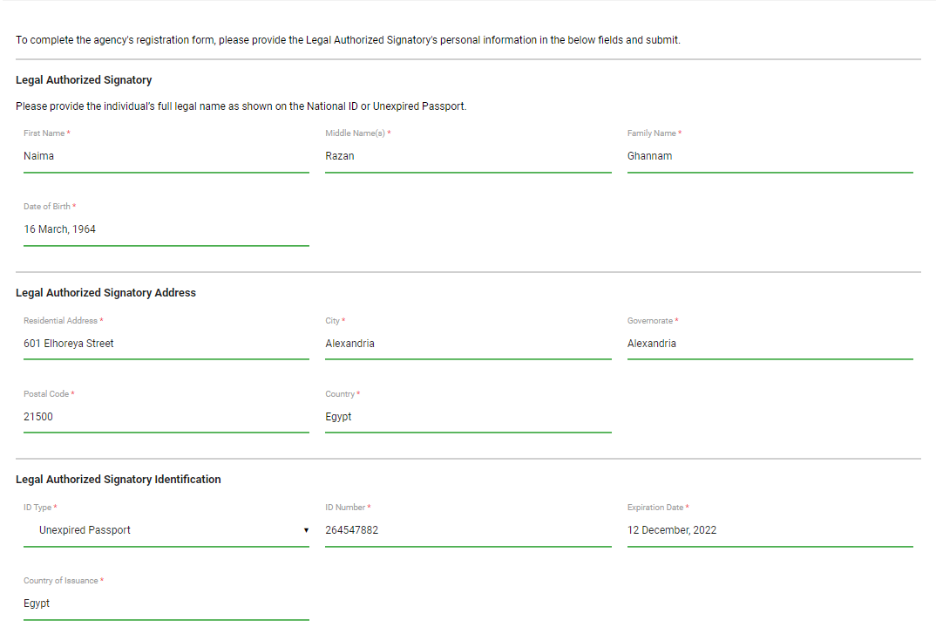
In order to submit the completed onboarding or registration form to create an IATA EasyPay Account, provide the personal information of the Legal Authorized Signatory and click Submit.

Slide 24
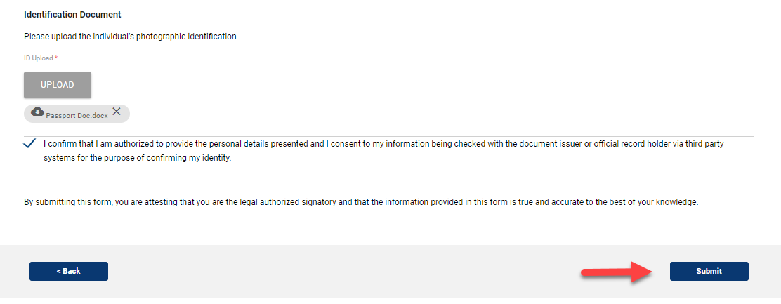

Slide 25
After Account Activation

Slide 26
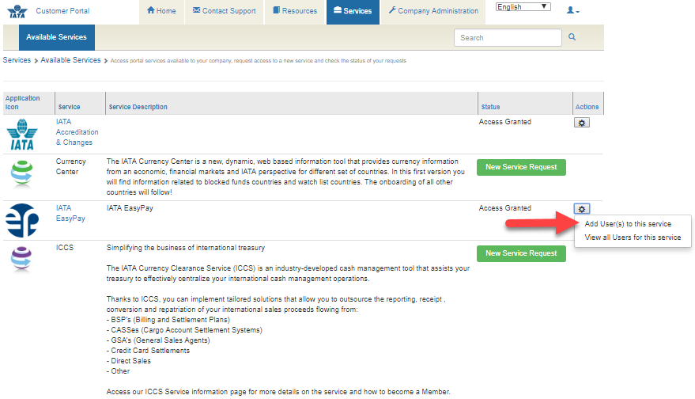
How Can Users be Added to an IATA EasyPay Account?

Slide 27
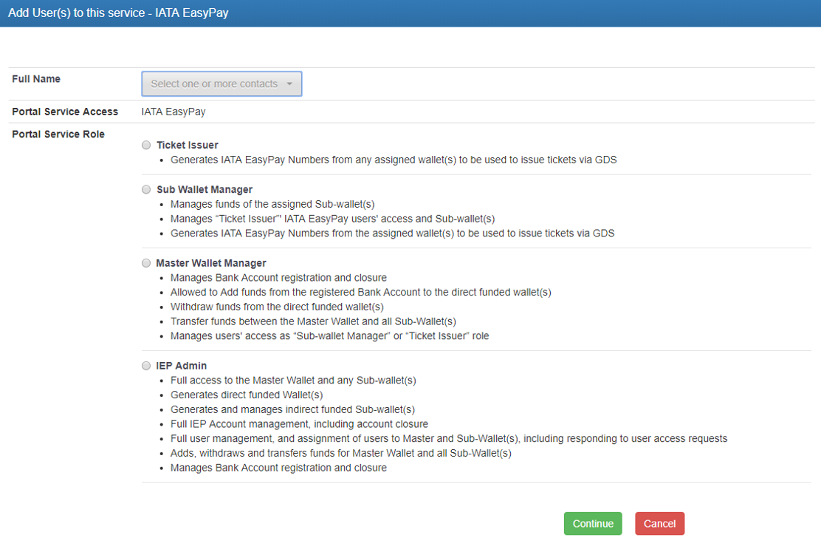

Slide 28
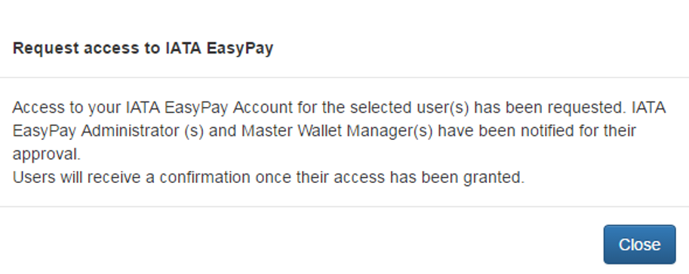
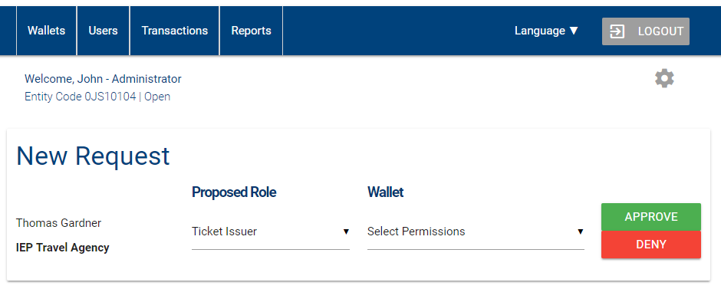

Slide 30
Where Can I Find User Access Requests?

Slide 31
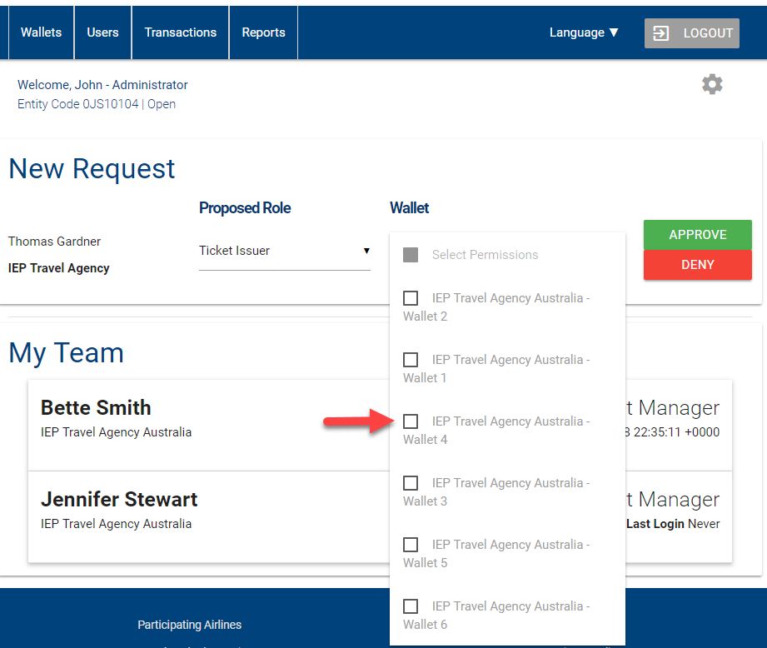

Slide 32
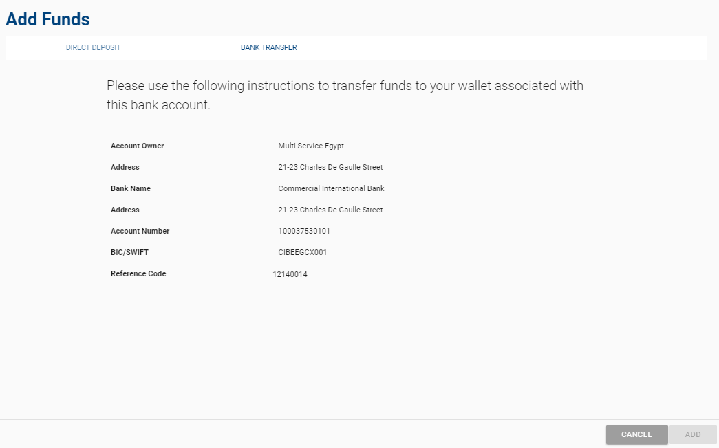
How Can Funds be Added?

Slide 33
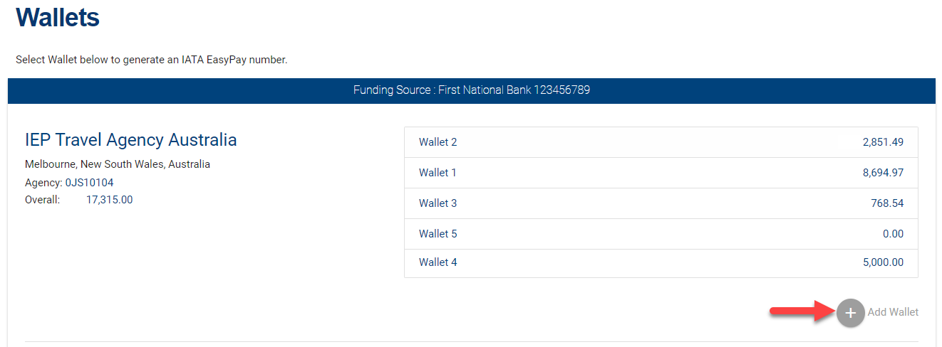
How Can a Wallet be Added

Slide 34
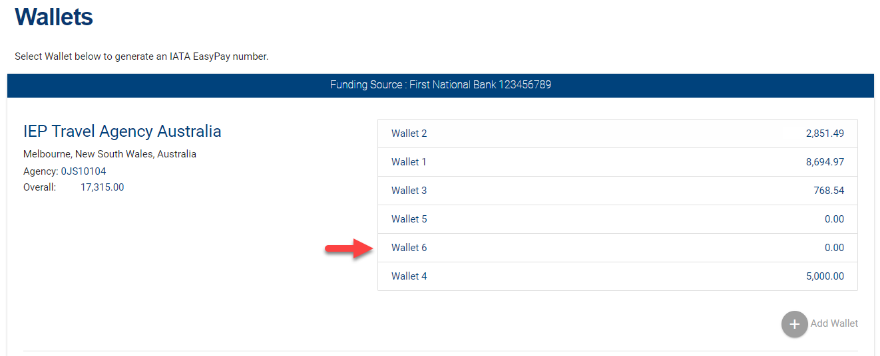

Slide 35
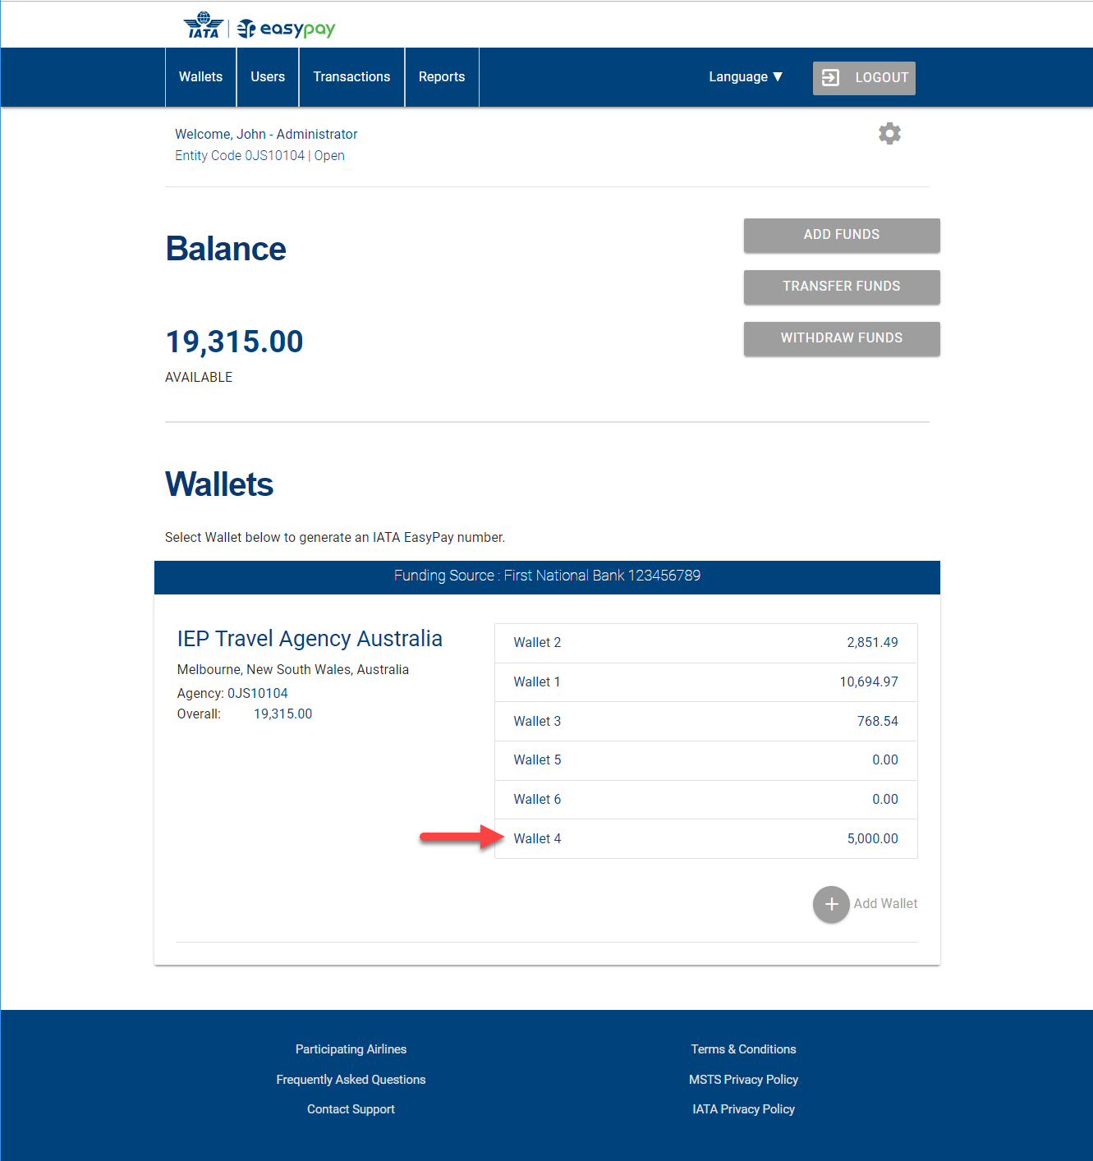
How is an IEP Number Generated?

Slide 36
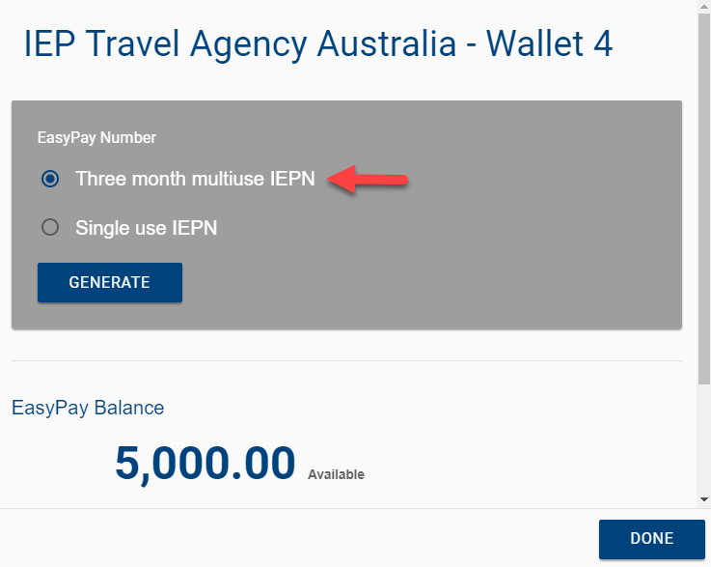

Slide 38
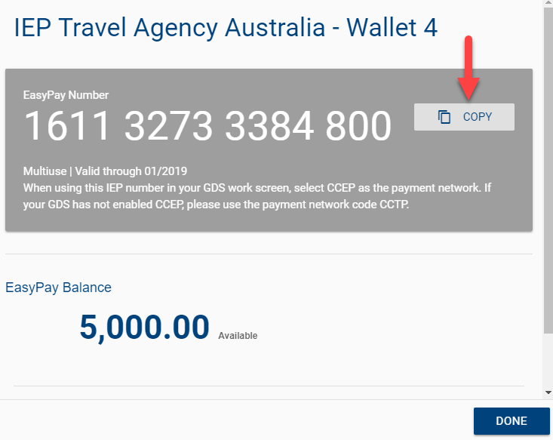

Slide 39
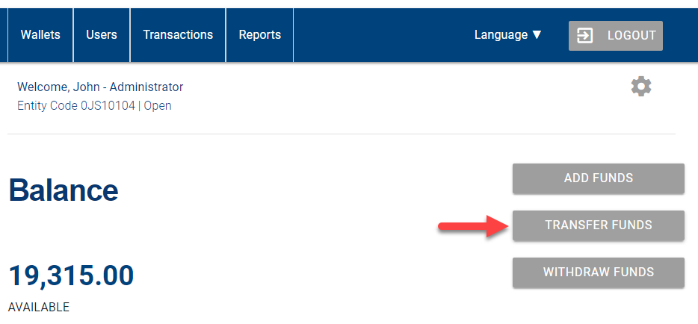
How Can Funds be Transferred Among Wallets?

Slide 40
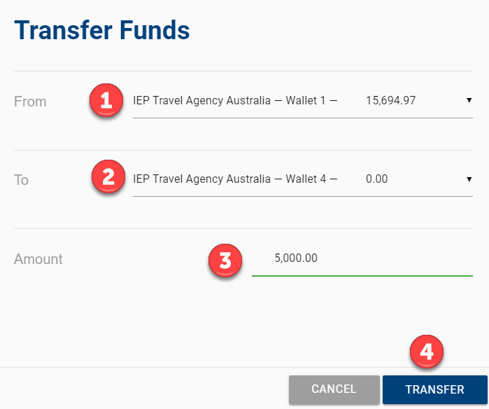
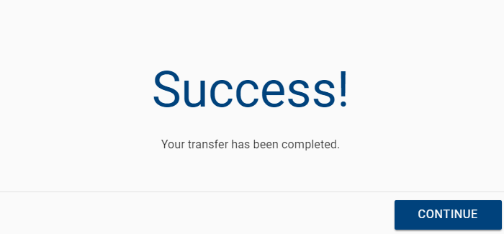

Slide 41
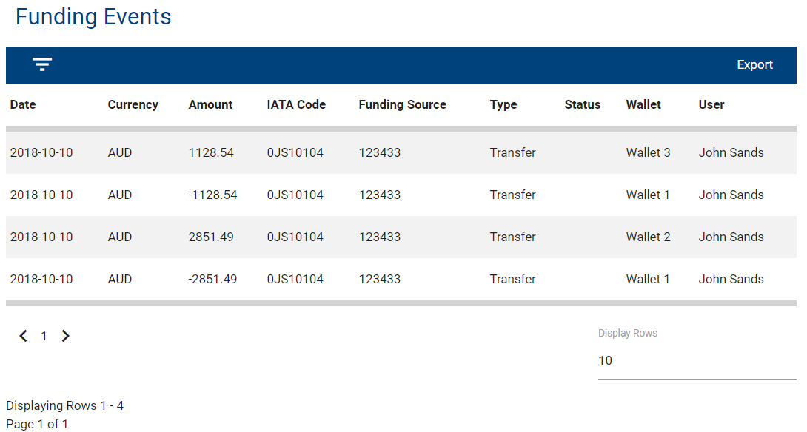
How Can Wallet Funding Movements be Reviewed?

Slide 42
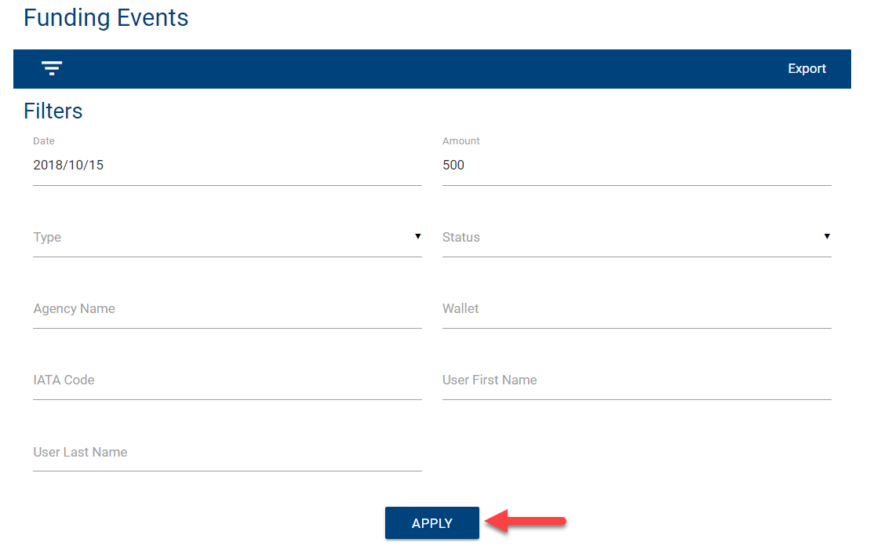
Filters can be applied by clicking on the filter button:

Slide 43
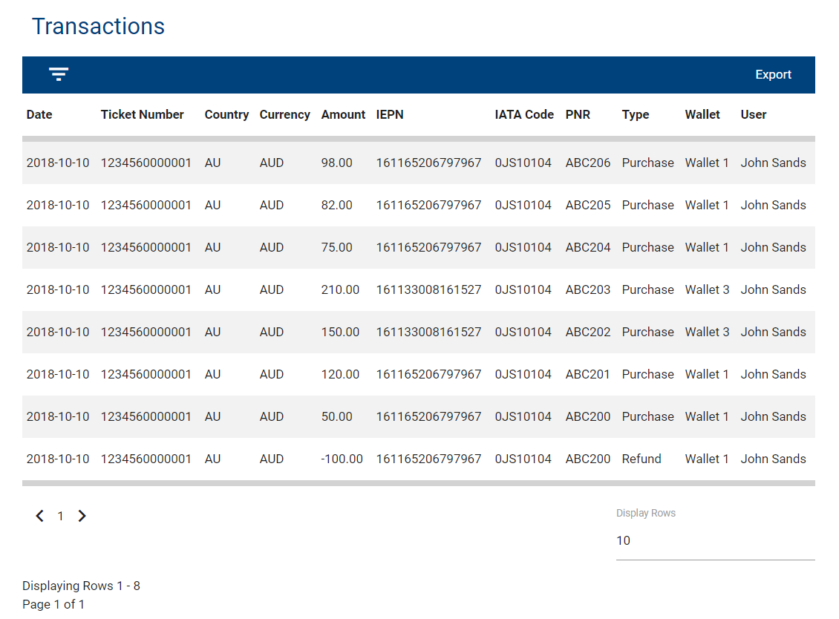
Where Can IATA EasyPay Transactions be Reviewed?

Slide 44
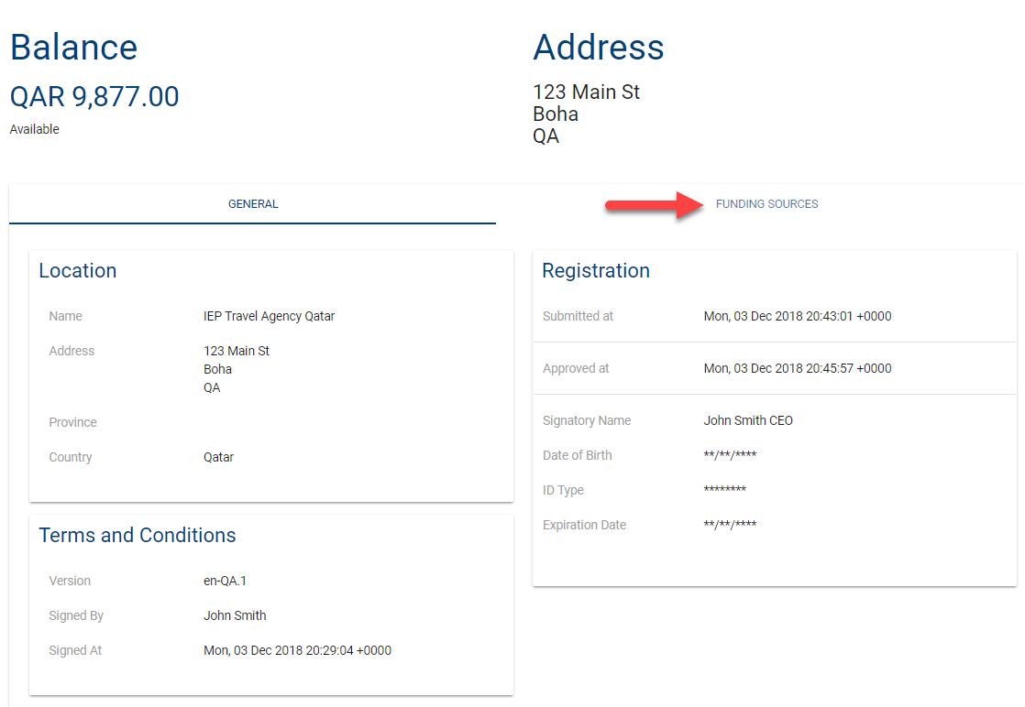
How do I Change my Funding Source?

Slide 45
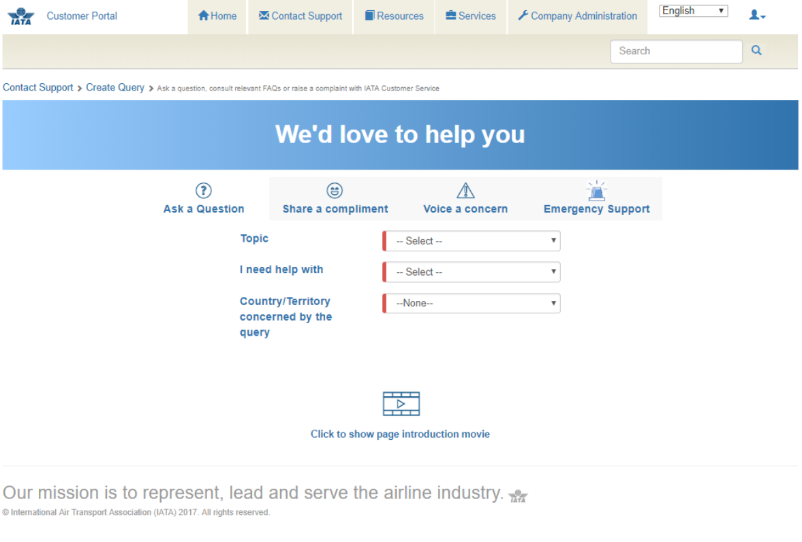
IATA EasyPay Help and Support

Slide 46
Thank you
TO REPLACE IMAGE:
Click on the picture, hit Delete
Click the ‘Add Picture’ icon
Find your image & click ‘Insert’
Under the ‘Format’ tab, click the ‘Crop’ button to adjust the position within the shape
** In order for the ‘Crop’ button to appear, please make sure you keep the shape selected at all times
Mostafa Charaf
charafm@iata.org
www.iata.org

